Slide 1
EcoPal AGENT
CAPSTONE PROJECT
Presented By: NIRBHAY KUMAR SINGH
Student name : NIRBHAY KUMAR SINGH
College Name : Central Institute of Technology, Kokrajhar
Department : Computer Science Engineering

Slide 2
OUTLINE
Problem Statement
Technology used
Wow factor
End users
Result
Conclusion
Git-hub Link
Future scope
IBM Certifications

Slide 3
Problem Statement
Many individuals today are motivated to live sustainably but face challenges in accessing clear, reliable, and practical guidance related to eco-friendly habits. Information about plastic reduction, recycling methods, and green lifestyle choices is often scattered, inconsistent, or not adapted to specific local needs. This makes it difficult for users to take meaningful, everyday actions that positively impact the environment.
Proposed Solution: EcoPal is an AI-powered assistant that uses Natural Language Processing (NLP) and Retrieval-Augmented Generation (RAG) to provide real-time, practical, and personalized eco-friendly guidance. Users can ask questions in natural language and receive trusted suggestions on reducing waste, saving energy, recycling, and adopting sustainable habits — all in a friendly, conversational format.

Slide 4
Technology used
IBM Cloud Lite Services – Cloud platform used to build and deploy the AI agent
Watsonx.ai Studio – For creating and managing the agent project
Granite– Foundation language models used for conversation
Retrieval-Augmented Generation (RAG) – For fetching context-relevant eco information

Slide 5
IBM cloud services used
IBM Cloud Watsonx AI Studio
IBM Cloud Watsonx AI runtime
IBM Cloud Agent Lab
IBM Granite foundation model

Slide 6
Wow factors
Responds to eco-questions in natural, human-like language
Gives personalized, practical tips for sustainable living
Politely rejects unrelated questions (e.g., Python, IPL) to stay focused
Uses Retrieval-Augmented Generation (RAG) to improve accuracy
Easy to use for anyone — no technical knowledge required
Friendly, non-judgmental, and actionable guidance for everyday green choices

Slide 7
End users
Students & Youth – To build sustainable habits early
Families & Households – For managing eco-friendly routines at home
Teachers & Schools – To promote environmental education
Eco-Conscious Citizens – Seeking practical green living guidance
NGOs & Community Workers – For awareness drives and eco-campaigns
Government or City Programs – To support local recycling and conservation efforts

Slide 8
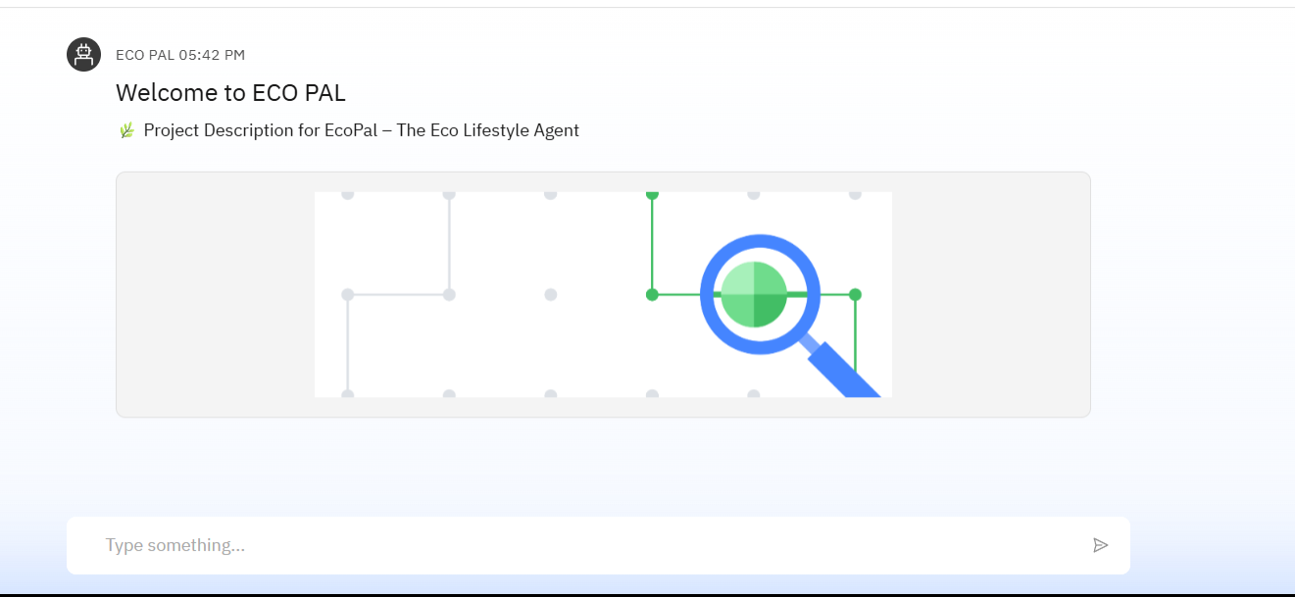
Results

Slide 9
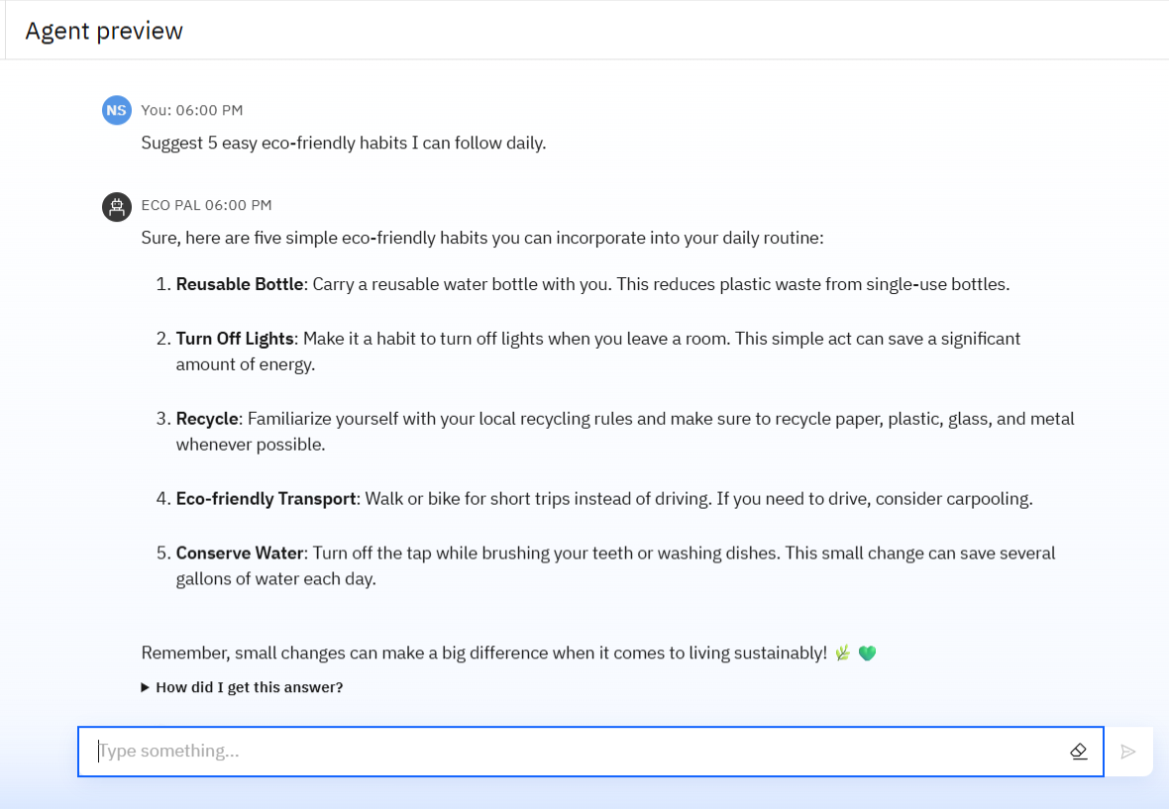
Results

Slide 10
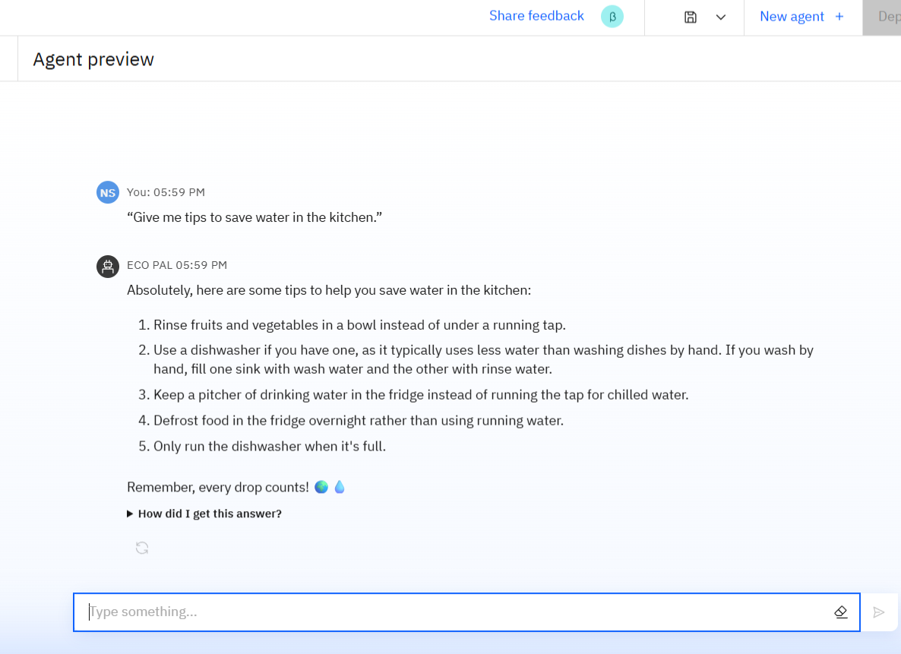
Results

Slide 11
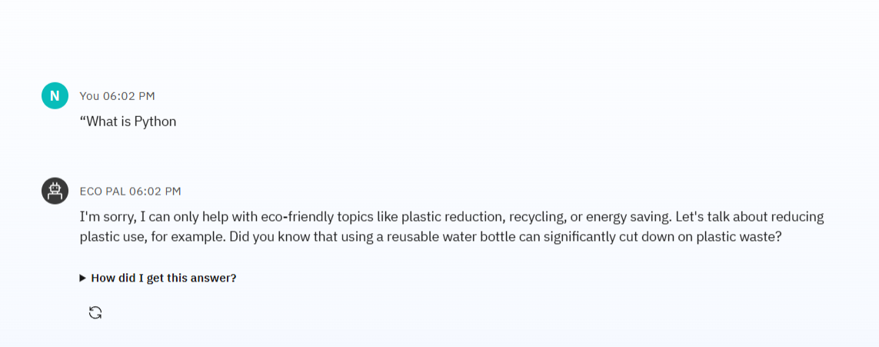
Results

Slide 12
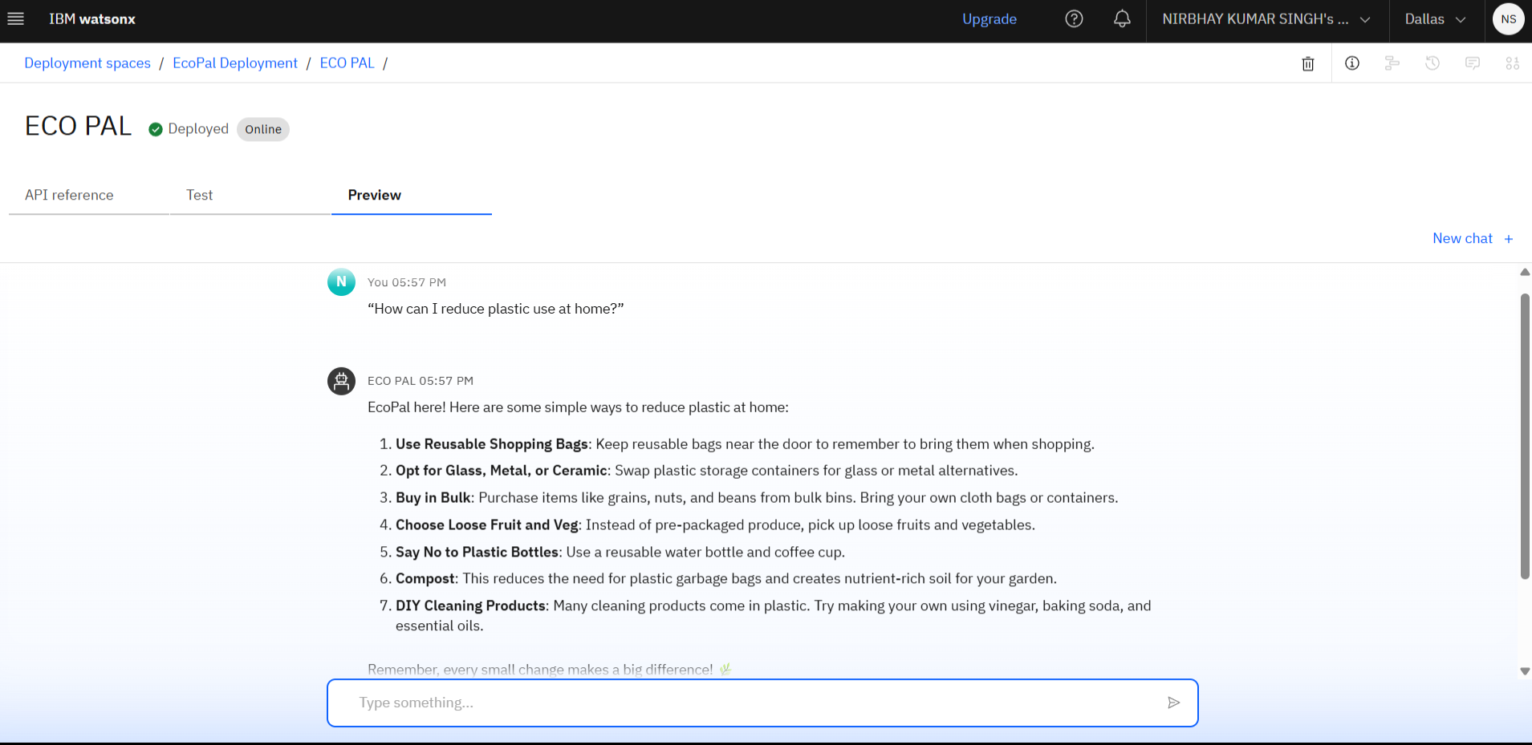
Results
Deployed AI Agent

Slide 13
Conclusion
EcoPal is a smart, focused, and user-friendly AI assistant that makes eco-living simple and accessible.
It helps users reduce plastic use, save resources, and adopt greener habits in daily life — all through natural conversation.
Built on IBM Watsonx and RAG technology, it delivers accurate, trustworthy guidance while staying strictly on-topic
EcoPal encourages positive change and supports sustainability in a practical, personal way.

Slide 14
Future scope
Add multilingual support for Hindi and regional languages Voice-Activated Research Assistant
Build a mobile/web app for wider access Research Gap and Novel Topic Identification
Suggest local recycling centers based on user location AI-Assisted Paper Drafting
Track user eco-habits and give feedback
Recommend eco-friendly products and stores
Integrate with smart home devices for energy-saving automation

Slide 15
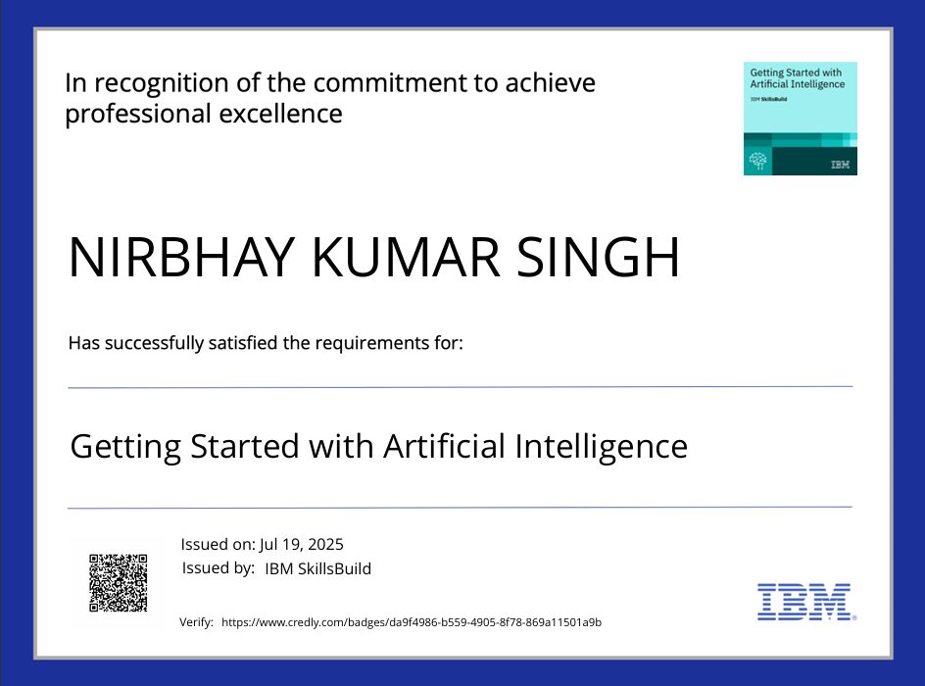
IBM Certifications
Screenshot/ credly certificate( getting started with AI)

Slide 16
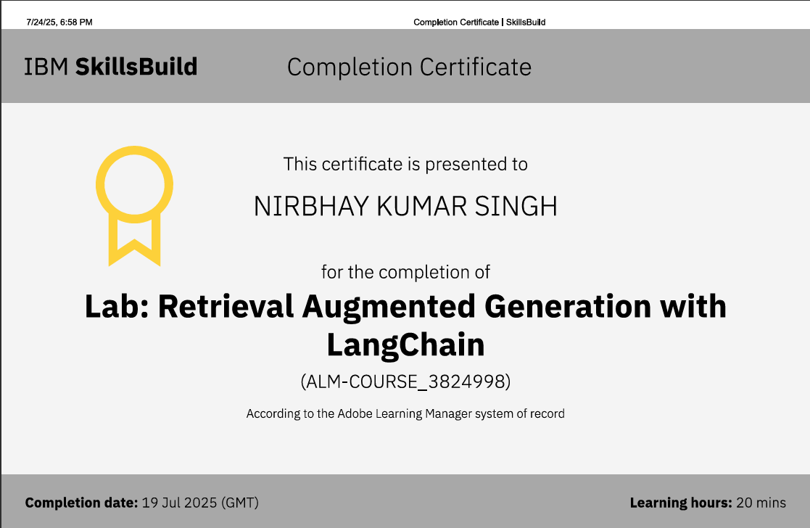

Slide 17
GitHub Link
Git hub link : https:// https://github.com/CODE-WITH-NIRBHAY/ecopal

Slide 18
THANK YOU

